Slide 1

Algebra 1
Unit 14, Lesson 1 Constructing Two-Way Tables Volume 2, pg. 305

Slide 2


Benchmarks
MA.912.DP.3.1
Construct a two-way frequency table summarizing bivariate categorical data. Interpret joint and marginal frequencies and determine possible associations in terms of a real-world context.
MA.912.DP.1.1
Given a set of data, select an appropriate method to represent the data, depending on whether it is numerical or categorical data and on whether it is univariate or bivariate.
MA.912.DP.1.2
Interpret data distributions represented in various ways. State whether the data is numerical or categorical, whether it is univariate or bivariate and interpret the different components and quantities in the display.
volume 2, pg. 305

Slide 3
Integrated Mathematical Thinking and Reasoning Standards
MA.K12.MTR.2.1 Demonstrate understanding by representing problems in multiple ways.
MA.K12.MTR.4.1 Engage in discussions that reflect on the mathematical thinking of self and others.
MA.K12.MTR.5.1 Use patterns and structure to help understand and connect mathematical concepts.
MA.K12.MTR.7.1 Apply mathematics to real-world contexts.
volume 2, pg. 305

Slide 4

Learning Targets
I can construct a two-way frequency table.
I can determine joint and marginal frequencies in a two-way frequency table.
volume 2, pg. 305

Slide 5

Warm-Up
volume 2, pg. 305

Slide 6
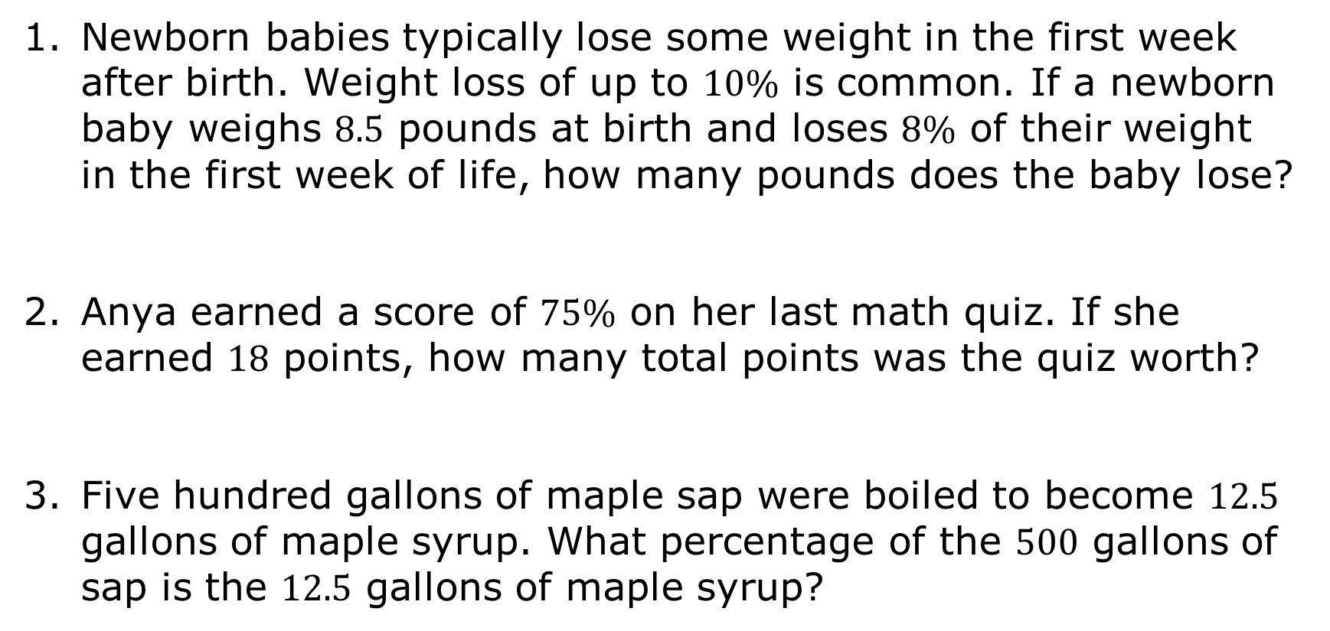
14.1.1 Warm-Up: Percent Calculations
Newborn babies typically lose some weight in the first week after birth. Weight loss of up to $10\%$ is common. If a newborn baby weighs $8.5$ pounds at birth and loses $8\%$ of their weight in the first week of life, how many pounds does the baby lose?
Anya earned a score of $75\%$ on her last math quiz. If she earned $18$ points, how many total points was the quiz worth?
Five hundred gallons of maple sap were boiled to become $12.5$ gallons of maple syrup. What percentage of the $500$ gallons of sap is the $12.5$ gallons of maple syrup?
volume 2, pg. 305

Slide 7

Guided Instruction
volume 2, pg. 306

Slide 8
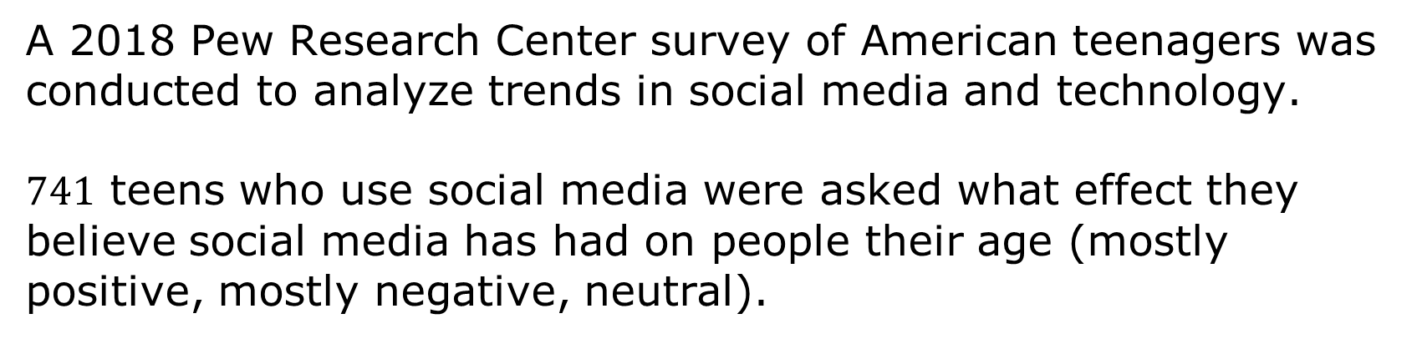
14.1.2 Guided Instruction: Two-Way Frequency Tables
A 2018 Pew Research Center survey of American teenagers was conducted to analyze trends in social media and technology.
$741$ teens who use social media were asked what effect they believe social media has had on people their age (mostly positive, mostly negative, neutral).
volume 2, pg. 306

Slide 9
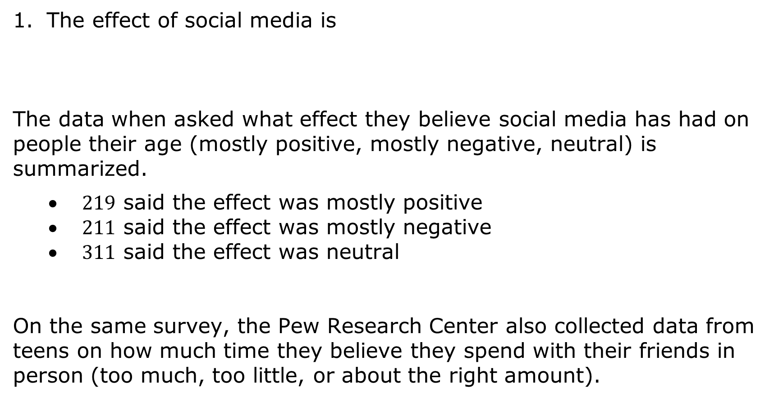
quantitative variable.
categorical variable.
The effect of social media is
The data when asked what effect they believe social media has had on people their age (mostly positive, mostly negative, neutral) is summarized.
$219$ said the effect was mostly positive
$211$ said the effect was mostly negative
$311$ said the effect was neutral
On the same survey, the Pew Research Center also collected data from teens on how much time they believe they spend with their friends in person (too much, too little, or about the right amount).
volume 2, pg. 306

Slide 10
Time spent with friends in person (too much, too little, or
just the right amount) is a
quantitative variable.
categorical variable.
A two-way frequency table is a display used to summarize bivariate categorical data. The table can also be called a contingency table or a joint frequency table.
volume 2, pg. 306

Slide 11
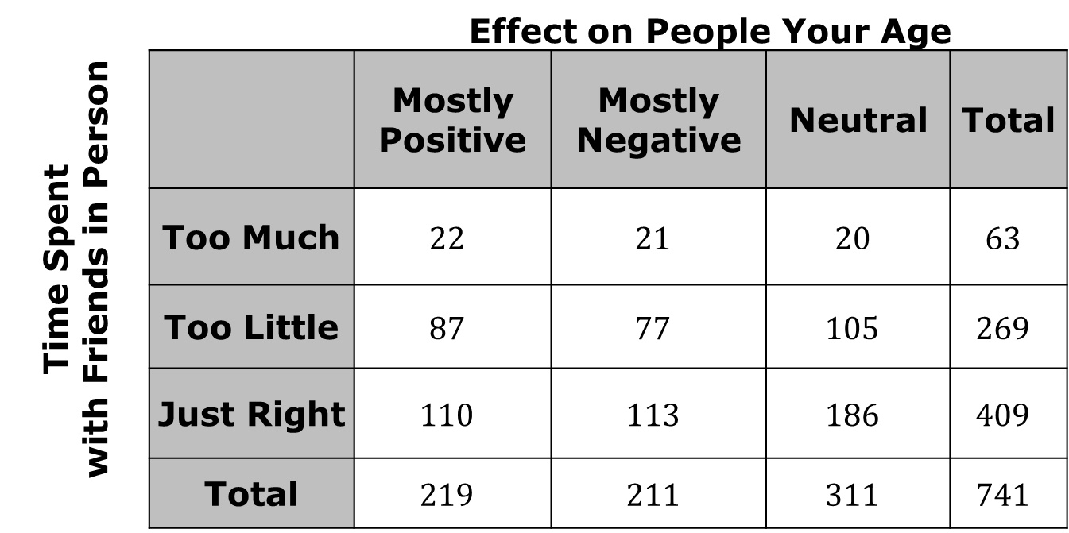
The two-way frequency table displays the results for teens when asked about the effect of social media, in addition to the results when being asked about time spent with friends in person.
Teen Social Media Survey
Time Spent with Friends in Person |  | Effect on People Your Age
 |  | Mostly Positive | Mostly Negative | Neutral | Total
 | Too Much | $$22$$ | $$21$$ | $$20$$ | $$63$$
 | Too Little | $$87$$ | $$77$$ | $$105$$ | $$269$$
 | Just Right | $$110$$ | $$113$$ | $$186$$ | $$409$$
 | Total | $$219$$ | $$211$$ | $$311$$ | $$741$$
volume 2, pg. 306

Slide 12
Circle the frequency for those who said the effect of social media was mostly positive.
Circle the frequency for those who said the effect of social media was mostly negative.
Circle the frequency for those who said the effect of social media was neutral.
volume 2, pg. 306

Slide 13
How many teens reported spending too much time with friends in person? Circle the value in the table.
How many teens reported spending too little time with friends in person? Circle the value in the table.
How many teens reported spending just the right amount of time with friends in person? Circle the value in the table.
Each of the values circled is a marginal frequency.
The total frequency for one category of a categorical variable, which is the total frequency for any row or column in a two-way frequency table, is called a marginal frequency.
volume 2, pg. 307

Slide 14
How many people reported that the effect of social media is mostly positive and reported that they spend too much time with friends in person?
How many people reported that the effect of social media is mostly negative and reported that they spend too much time with friends in person?
How many people reported that the effect of social media is mostly negative and reported that they spend too little time with friends in person?
volume 2, pg. 307

Slide 15


In a two-way table, a joint frequency is the number of times a combination of two conditions occurs.
Draw a box around each joint frequency in the table.
What percentage of respondents reported that the effect of social media is mostly positive and reported that they spend too much time with friends in person?
$$=$$
volume 2, pg. 307

Slide 16

What percentage of respondents reported the effect of social media is mostly negative and reported that they spend too much time with friends in person?
$$=$$
In a two-way table, a joint relative frequency is the ratio of the joint frequency and the total number of data points.
volume 2, pg. 307

Slide 17

Collaboration
volume 2, pg. 308

Slide 18

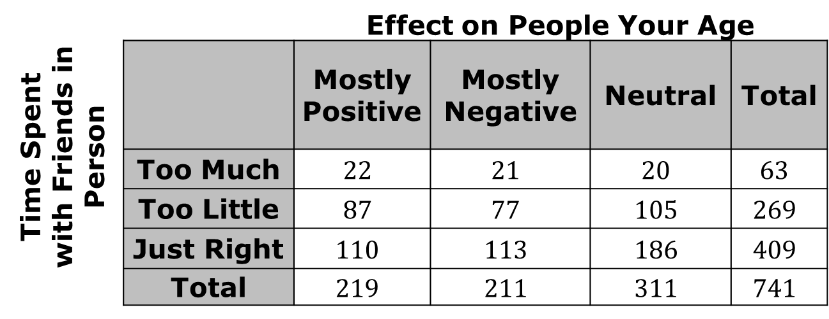
14.1.3 Collaboration: Interpreting a Two-Way Table
With your partner, use the two-way frequency table to determine if each statement in the table is true or false. If a statement is false, correct the statement to make it true.
Teen Social Media Survey
Time Spent with Friends in Person |  | Effect on People Your Age
 |  | Mostly Positive | Mostly Negative | Neutral | Total
 | Too Much | $$22$$ | $$21$$ | $$20$$ | $$63$$
 | Too Little | $$87$$ | $$77$$ | $$105$$ | $$269$$
 | Just Right | $$110$$ | $$113$$ | $$186$$ | $$409$$
 | Total | $$219$$ | $$211$$ | $$311$$ | $$741$$
volume 2, pg. 308

Slide 19
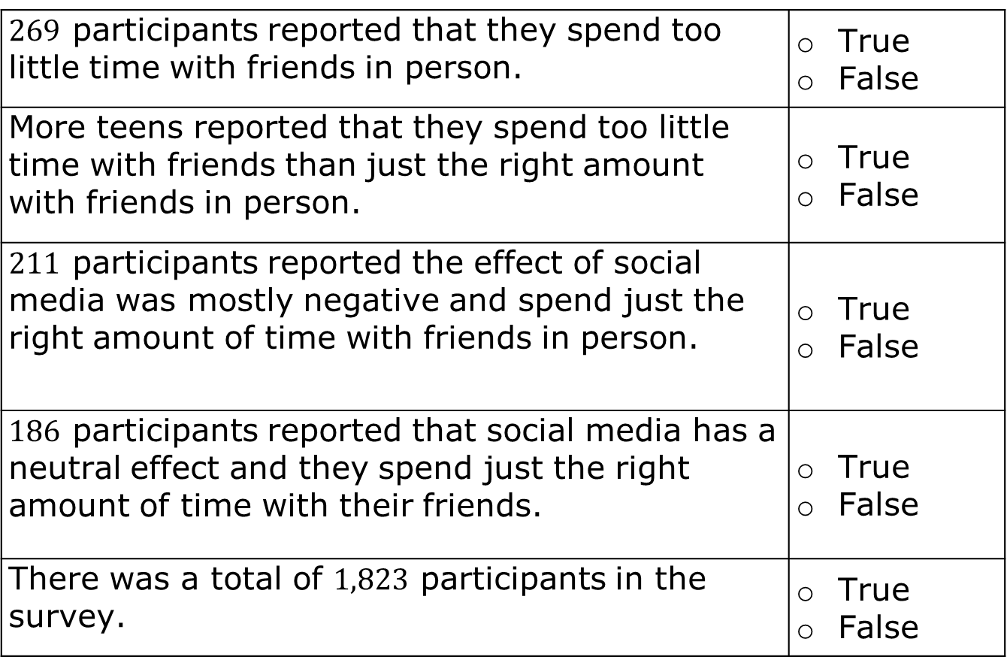
$269$ participants reported that they spend too little time with friends in person. | True False
More teens reported that they spend too little time with friends than just the right amount with friends in person. | True False
$211$ participants reported the effect of social media was mostly negative and spend just the right amount of time with friends in person. | True False
$186$ participants reported that social media has a neutral effect and they spend just the right amount of time with their friends. | True False
There was a total of $1,823$ participants in the survey. | True False
volume 2, pg. 308

Slide 20

Guided Practice
volume 2, pg. 308

Slide 21

14.1.4 Guided Practice: Constructing a Two-Way Table
Kieran decides to gather data on hair and eye color for his genetics project in science. Kieran’s data is shown.
The table shows the number of people who match each description.
Brown Hair, Brown Eyes | Brown Hair, Blue Eyes | Blonde Hair, Brown Eyes | Blonde Hair, Blue Eyes
33 | 18 | 11 | 24
volume 2, pg. 308

Slide 22
Construct a two-way frequency table to summarize the data.
 |  |  | Total
Total
volume 2, pg. 308

Slide 23
The total number of students surveyed with brown eyes is ________ .
This value represents a
The total number of students surveyed with brown eyes and blonde hair is ________ .
This value represents a
marginal frequency.
joint frequency.
marginal frequency.
joint frequency.
volume 2, pg. 309

Slide 24

Try It
volume 2, pg. 309

Slide 25

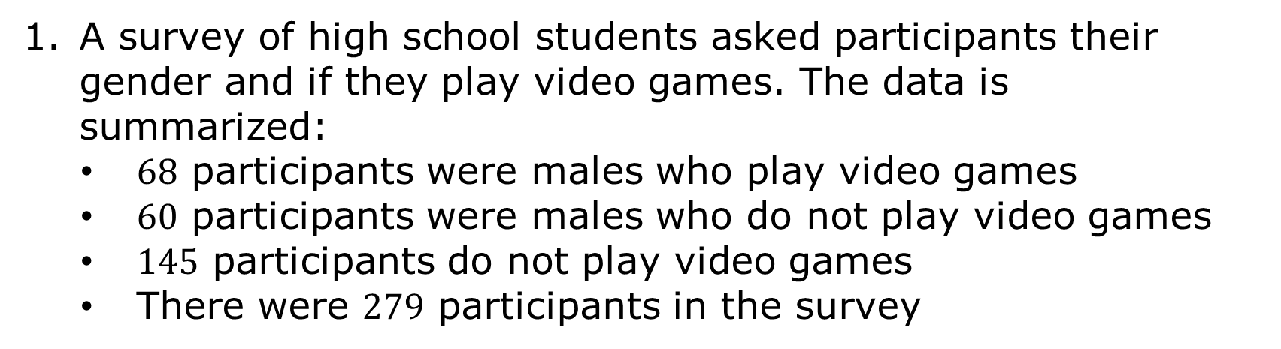
14.1.5 Try It: Constructing a Two-Way Table
A survey of high school students asked participants their gender and if they play video games. The data is summarized:
$68$ participants were males who play video games
$60$ participants were males who do not play video games
$145$ participants do not play video games
There were $279$ participants in the survey
volume 2, pg. 309

Slide 26
Complete the joint frequency table.
Student Video Game Activity
 | Play Video Games | Do Not Play Video Games | Total
Male
Female
Total
volume 2, pg. 309

Slide 27
How many female students and do not play video games?
Of the students who play video games, how many were female?
How many students surveyed play video games?
volume 2, pg. 309

Slide 28
Jackson County Schools, located in Marianna, Florida, conducted a student survey to find out how students spend the majority of their free time outside of school.
The data of this survey is shown in tables below.
Elementary Students
On the Phone | Playing Video Games | Reading
389 | 863 | 1,242
Middle School Students
On the Phone | Playing Video Games | Reading
532 | 557 | 481
High School Students
On the Phone | Playing Video Games | Reading
978 | 844 | 224
volume 2, pg. 310

Slide 29
Construct a two-way frequency table that shows all of the survey data.
volume 2, pg. 310

Slide 30

Wrap-Up
volume 2, pg. 310

Slide 31
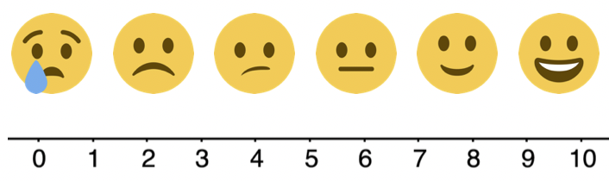
14.1.6 Wrap-Up: Reflection
Rate your confidence in creating two-way tables to display bivariate categorical data.
What are some questions you still have about two-way frequency tables?
volume 2, pg. 310

